Slide 1
Development of a CIPAC washing method for long-lasting insecticidal nets (LN)
Testing of the CIPAC washing agent concentration
Olivier Pigeon (CRA-W, Gembloux)
Yumiko Kozuki (Sumitomo)
Tsunehisa Fujita (Sumitomo)
Markus Mueller (Agroscope, Waedenswil)
Bruno Patrian (Agroscope, Waedenswil)
Martin Rodler (Syngenta)
55th CIPAC Technical Meeting
Beijing, China, 15 June 2011

Slide 2
Samples
Olyset® : permethrin 20 g/kg long-lasting (incorporated into polyethylene) insecticidal mosquito net (LN)
DuraNet® : alpha-cypermethrin 5.8 g/kg long-lasting insecticidal (incorporated into polyethylene) mosquito net (LN)
PermaNet® 2.0 : deltamethrin 1.4 g/kg long-lasting (coated onto polyester) insecticidal mosquito net (LN) (100 denier)
NetProtect® : deltamethrin 1.8 g/kg long-lasting (incorporated into polyethylene) insecticidal mosquito net (LN)

Slide 3
Laboratories
Sumitomo, Japan (Yumiko Kozuki and Tsunehisa Fujita) for the testing of Olyset®
Agroscope, Waedenswil, Switzerland (Markus Müller and Bruno Patrian) for the testing of DuraNet®
Walloon Agricultural Research Centre (CRA-W), Gembloux, Belgium (Olivier Pigeon) for the testing of PermaNet® 2.0 and NetProtect®

Slide 4
CIPAC washing agent
Composition | Percent
Sodium oleate | 12.0
Polyoxyethylene glycol (25) monostearate | 8.0
Water | 80.00
Total (%w/w) | 100.00

Slide 5
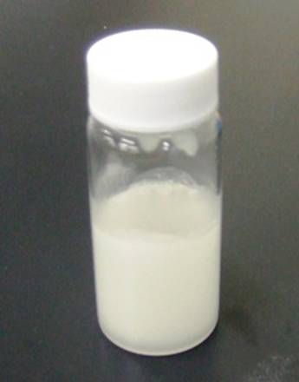
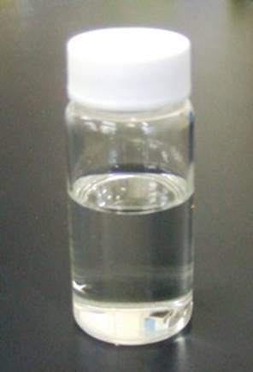
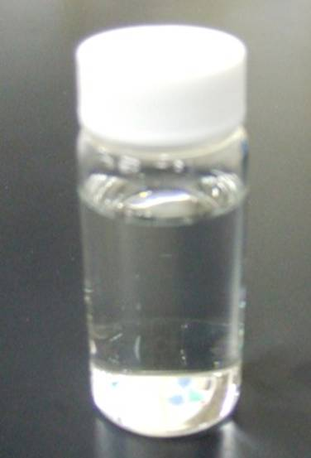
CIPAC washing agent
1. Heat Polyoxyethylene glycol (25) monostearate up to 50ﾟC for decreasing the viscosity
2. Prepare the water phase
50 ﾟC
Heating
Waxy Polyoxyethylene glycol (25) monostearate
Liquid Polyoxyethylene glycol (25) monostearate
Ion-exchanged water

Slide 6
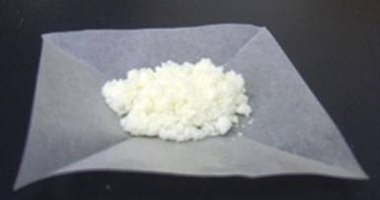
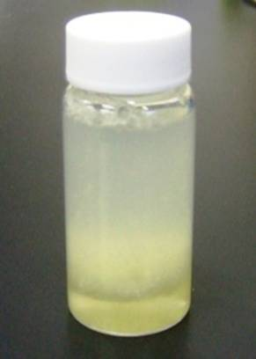
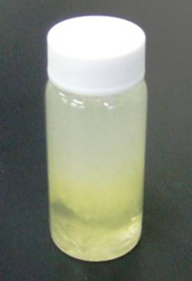
CIPAC washing agent
3. Add surfactants into water phase
Sodium oleate
Addition
Ion-exchanged water
Ion-exchanged water + Sodium oleate
Liquid Polyoxyethylene glycol (25) monostearate
Addition
Ion-exchanged water + Surfactants

Slide 7
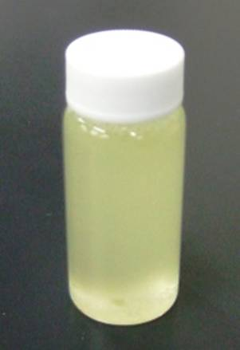
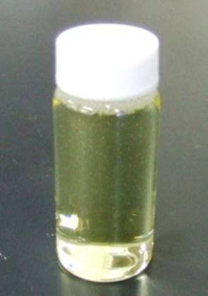
CIPAC washing agent
4. Heat CIPAC washing agent stirring down at 50ﾟC until it becomes a homogeneous liquid
50 ﾟC
50 ﾟC
Heating & Shaking
Heating & Shaking
Ion-exchanged water + Surfactants
CIPAC washing agent
Irreversible
Irreversible

Slide 8
Sampling
For each wash cycle : 3 pieces of 25 cm x 25 cm
cut in the length of the net, parallel to the lower border

Slide 9
Washing method
Washing of 3 individual pieces of 25 cm x 25 cm with 500 mL soap solution in a reciprocal water bath shaker at 155 beats / minute with an amplitude of 15 mm at 30°C ± 2°C for 10 minutes
Rinsing 2 times with 500 mL deionized water in a reciprocal water bath shaker at 155 beats / minute with an amplitude of 15 mm at 30°C ± 2°C for 10 minutes
The next action varies depending on LN types
- Coated LN : Drying on a line at ambient temperature protected from direct sunlight for 30
minutes and then at 30°C ± 2°C in the dark for a time period of 22 ± 2 hours before the
next washing
- Incorporated LN : Drying on a line at ambient temperature protected from direct sunlight
for 30 minutes and then at 40°C ± 2°C in the dark for a time period of 22 ± 2 hours before
the next washing
After the wash cycles, storage of the pieces into an aluminium foil in a freezer at 4°C
(± 3°C)

Slide 10
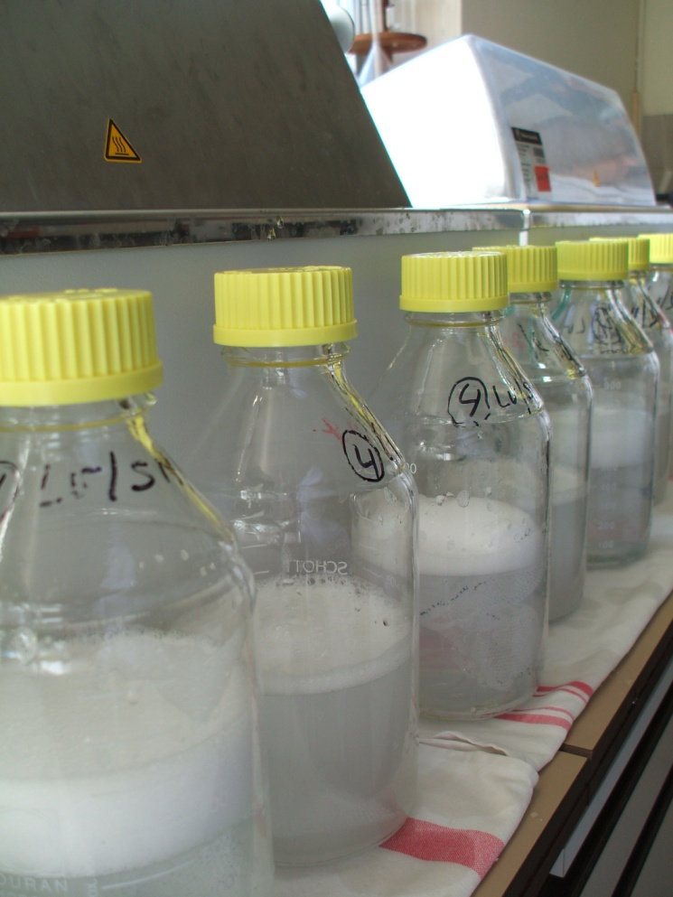
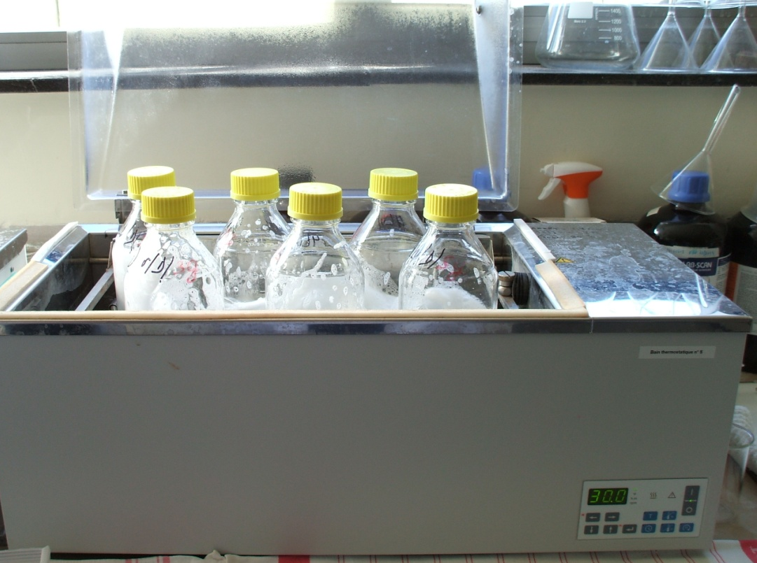
Washing method
The following soap / detergents were compared
- Marseille soap at 2 g/L
- CIPAC washing agent at 2 g/L
- CIPAC washing agent at 4 g/L
- CIPAC washing agent at 8 g/L
Wash cycles : 0, 1, 2, 3, 4, 5

Slide 11
Active ingredient content
After the washing procedure, determination of a.i. content in each individual piece [1 determination for each individual piece]
Results expressed as g active ingredient per kg netting material
Calculation: mean and RSD of the 3 pieces for each wash cycle and retention (wash resistance) index using the equation for a free migration stage behaviour
Average a.i. retention index = ^{n}√(t_{n}/t₀)
where t_{n} = active substance total content after wash n, g/kg
t₀ = active substance total content at wash 0 (pre-washing), g/kg
n = number of washes

Slide 12
Active ingredient content
Methods for a.i. content
Olyset®
CIPAC method 331/LN/M/3 (permethrin in incorporated nets)
CIPAC Handbook M, page 159
DuraNet®
CIPAC method 454/LN/M/3.2 (alpha-cypermethrin in incorporated nets
CIPAC Handbook M, page 41
PermaNet® 2.0
CIPAC method 333/LN/(M)/3 (deltamethrin in coated nets)
CIPAC Handbook M, page 66
NetProtect®
extension of CIPAC method 333/LN/(M)/3 (deltamethrin in incorporated nets)

Slide 13
Results
Olyset®

Slide 14
Results
Olyset®

Slide 15
Results
PermaNet® 2.0

Slide 16
Results
PermaNet® 2.0

Slide 17
Results
NetProtect®

Slide 18
Results
NetProtect®

Slide 19
Results
DuraNet®

Slide 20
Results
DuraNet®

Slide 21
Conclusion
Precision of the CIPAC LN wash method
(RSD of the a.i. content on the 3 net pieces)
- Olyset® = 0.3 to 2.1%
- PermaNet® 2.0 (100 Denier) = 0.3 to 8.2%
- NetProtect® = 0.2 to 4.4%
- DuraNet® = 1.1 to 8.9%
Good precision
Precision not correlated
- with the number of washes
- the type of soap / detergent
- the concentration of the detergent

Slide 22
Conclusion
Comparison between CIPAC washing agent and Marseille soap
For incorporated LNs
No significant difference between the 4 objects tested
For coated LNs
- The retention index decreases when the CIPAC washing
agent concentration increases
- 4 g/L CIPAC washing agent close to 2 g/L Marseille soap
→ Propose to specify 5 g/L in the CIPAC method
RI0-4 | Marseille soap 2 g/L | CIPAC washing agent 2 g/L | CIPAC washing agent 4 g/L | CIPAC washing agent 8 g/L
Olyset® | 99.5 | 99.3 | 98.9 | 98.2
PermaNet® 2.0 | 84.3 | 93.9 | 89.7 | 78.2
NeProtect® | 97.0 | 99.9 | 97.2 | 99.3
DuraNet® | 98.3 | - | - | 98.4

Slide 23
Thank you for your attention
“LNPAC”
Olivier Pigeon (CRA-W, Gembloux)
Yumiko Kozuki (Sumitomo)
Tsunehisa Fujita (Sumitomo)
Markus Mueller (Agroscope, Waedenswil)
Bruno Patrian (Agroscope, Waedenswil)
Martin Rodler (Syngenta)

